Slide 1
To be heard: Generating Evidence of Girl’s Menstrual Hygiene Management Information Needs In Pakistan
Authors: Dr. Zubia Mumtaz, Dr. Marni Sommer and Afshan Bhatti
Background
Method
A small body of literature suggests a key element of cultural practices
surrounding reproductive health in Pakistan, including menstruation, is the ‘culture of silence’. Part of a larger value system that is embedded within the gender order of society, information around menstruation is actively withheld until after the onset of menstruation.
1. Qualitative research
2. Data collected from four districts (two rural and two urban)
Rural Disricts
Urban Districts
A number of studies have suggested girls’ knowledge around menstruation and hygiene practices is inadequate and is often associated with profound psychological and emotional problems.
3. Participatory activities with girls (n=361) aged 14-19 years, both in- and out-of-school.
A research study was conducted in Baluchistan and Punjab provinces in Pakistan to assess pubertal girls’ needs for information around menstruation and its management.
4. Observations of school water, sanitation and disposal facilities
5. In-depth interviews with key informants (parents, teachers, and health workers, education officials and school administrators.
When I had my first period, I did not know anything about it. I was at home at that time. I was getting ready for school one morning when I felt my shalwar (pants) was wet. I was surprised because I had not sat in water or anything. I went to the washroom and checked my shalwar. I got very scared and I thought that I had developed cancer.”
(9th grader, Lasbela, Balochistan Province)
Objectives
Results
To collect data around girls’ experiences of menarche, through deeper exploration of cultural values, beliefs and practices surrounding menstruation, and how the lack of water, sanitation and disposal infrastructure
Six overarching themes:
Menarche (the onset of menstruation) is generally experienced by girls as a traumatic event.
Prior knowledge of menarche normalized the process,
leading to positive experiences of the first menstrual period.
Girls’ knowledge of puberty and menstrual practices is rooted in local, cultural epistemology. However, some are skeptical of this knowledge and question it.
Significant information gaps exist, specifically around physiology of puberty and menstruation; recognition and relief of menstrual symptoms; appropriate MHM practices; and social, physical, religious and dietary restrictions.
Water, sanitation, and hygiene facilities in schools are inadequate to meet menstruating girls’ needs, with consequences for regular schooling.
Need for Girl- Friendly schools incorporating MHM facilities
beliefs
?
water
toilet disposal
may negatively impact girl’s management of menstruation in schools, and ability to participate in the classroom.
Girls Boys
To generate evidence to inform a Pakistan-specific girls’ puberty book that provides essential, culturally sensitive information on puberty and menstrual hygiene management (MHM)
Girls’ puberty book
Conclusions
Recommendations emanating from the study:
Need for MHM-specific information & education tools: Books, Health Education Course, or an Online Educational Video
Girls’ puberty book
Training and education sessions to sensitize teachers on MHM
Provision of adequate WASH infrastructure as well as maintenance of existing ones
Inclusion of a MHM health education module as part of the girls’ school curriculum.
Girls Boys

Slide 2
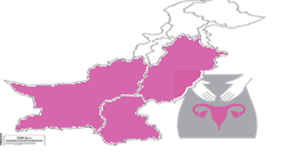
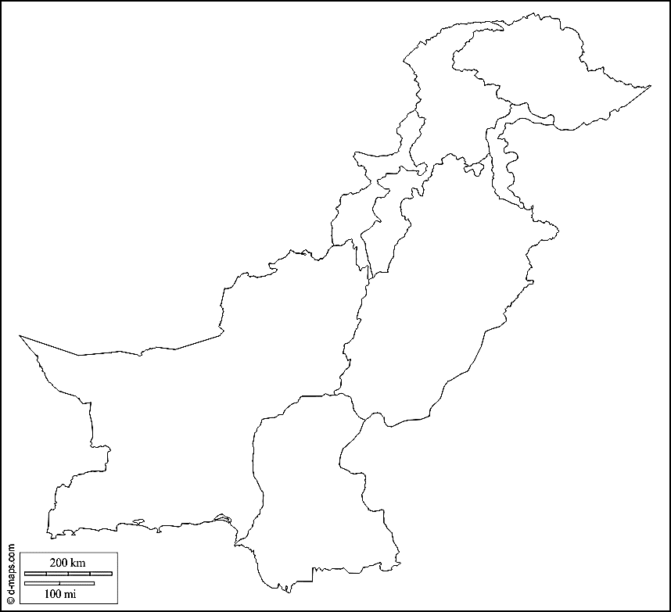
Rural Disricts
Urban Districts

